Slide 1
AF subtraction

Slide 2
Order of operation issue
In the past I subtracted and then did a dark frame subtraction. This made me believe that it was not a good process. It was patchy and created these really diffuse emitting structures. It was like a huge convolution.
I believe the main issue was the subtraction caused artificial dips. Normally this is not an issue, but it interferes with the main operation of dark frame generation, ie find the lowest pixel in the region and interpolate from there.
Order revised to FF correction, exp time scaling on bleached image (with 10% taken to force to be a lower bound due to exp time extrapolation errors), DF subtraction on each individually, then flat subtraction from each other.

Slide 3
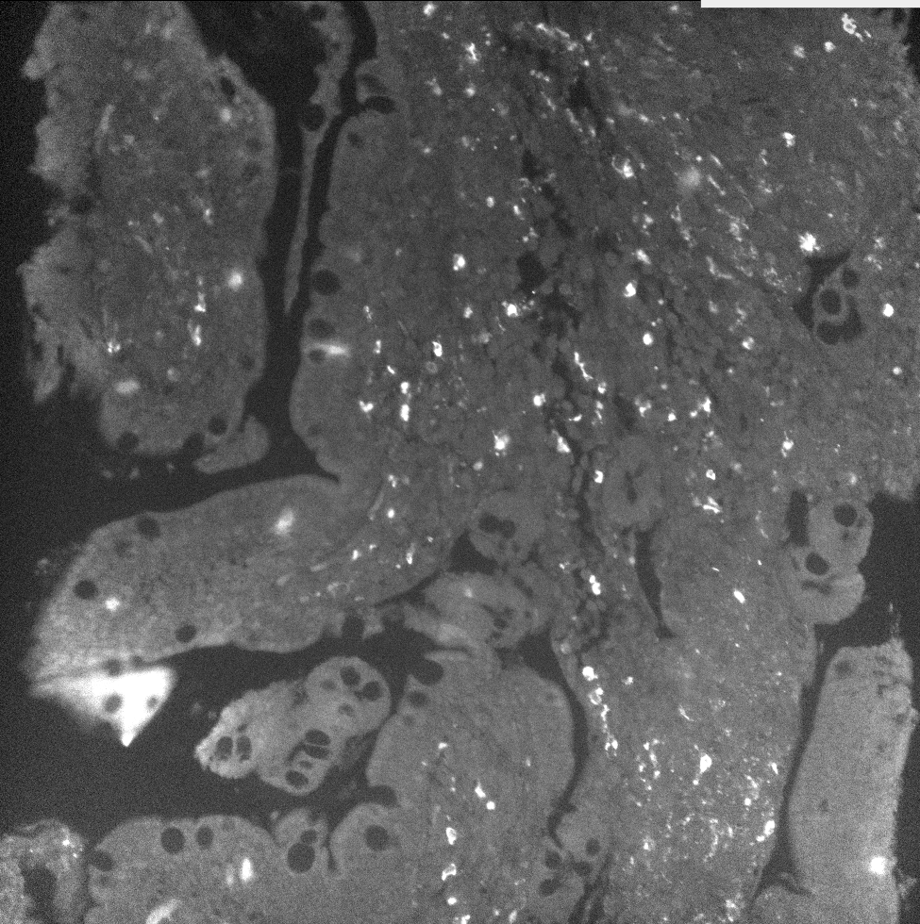
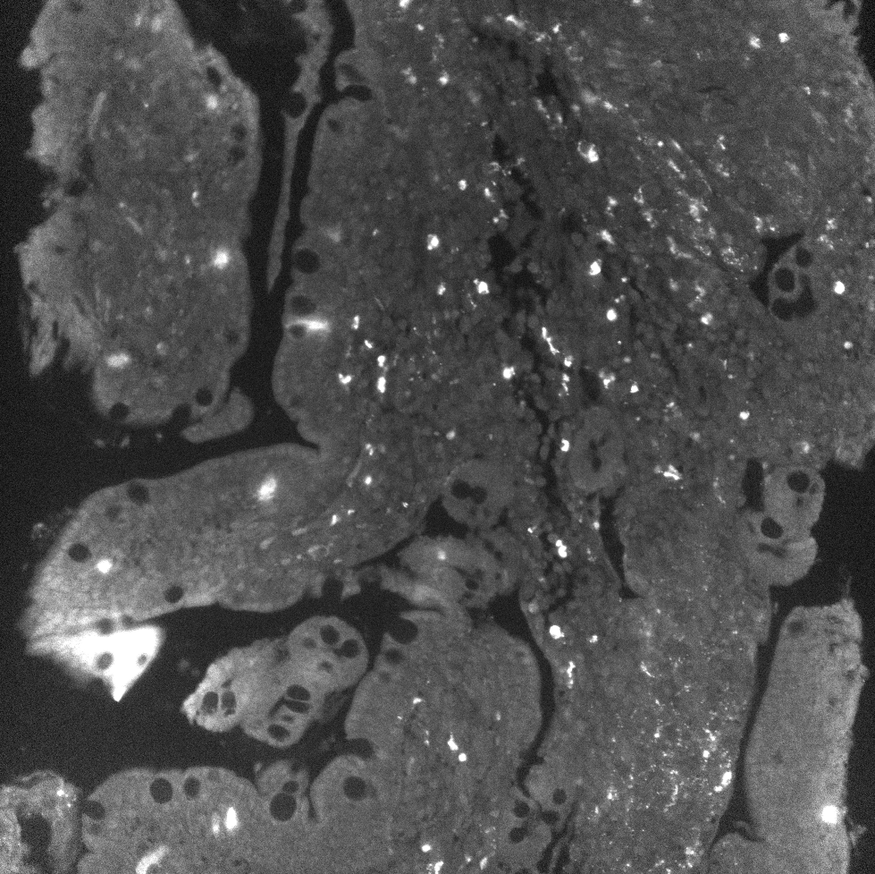
Examples
FF stain cy2
FF bleach after cy1
Hard to tell what is what. A488 channel has many bright cells. Lets look at merges to emphasize

Slide 4
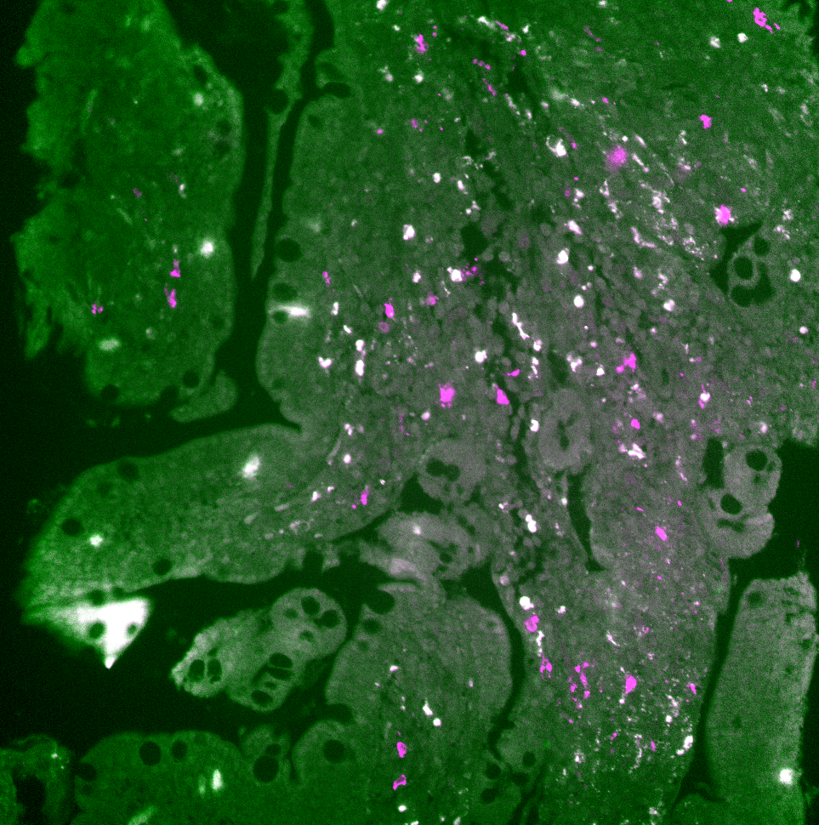
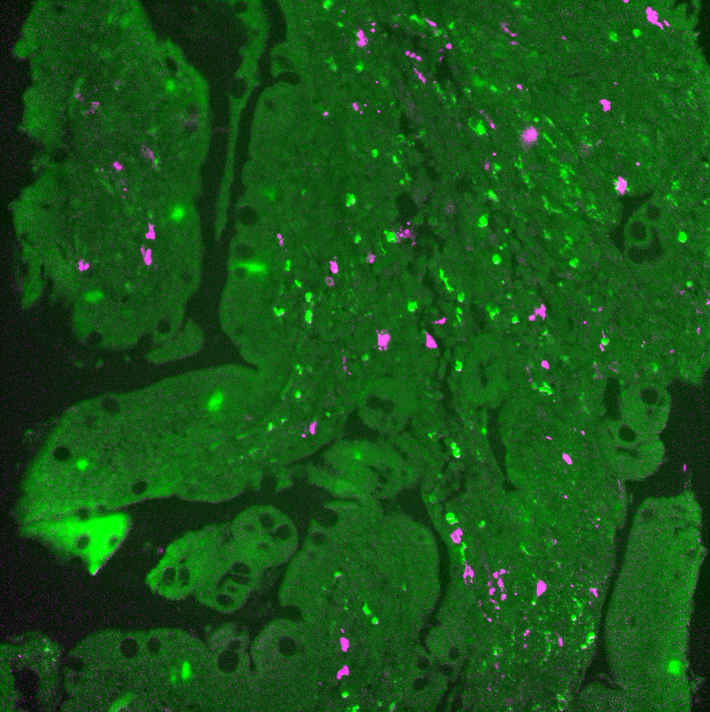
Merged differences
Green = AF
Magenta = Stain
White = magenta + green colocalize
Notice in the merged unsubtracted images that a large amount of white exists.
In the merger of the subtracted stained image with AF, virtually no white exists. Meaning AF has ben successfully suppressed to a sufficient degree.
Merge of stain and AF
Merge of AF subbed stain and AF

Slide 5
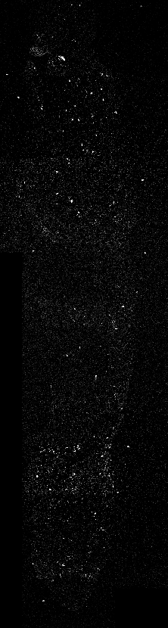
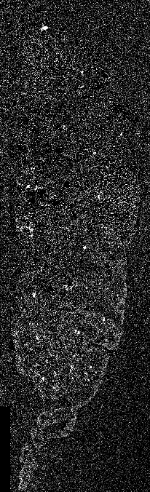
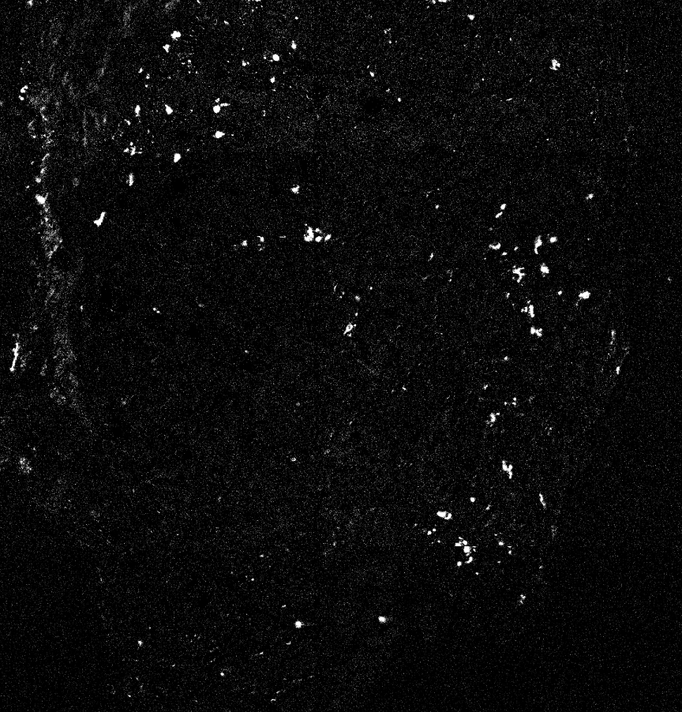
Eveness
Given the DF subbing is individual and subbing after it, it may cause tile to tile brightness unevenness. Lets check
Brightness matching between tiles is very good in this instance!

Slide 6
Suppression of very strong left over patterns
Unfortunately, some stains have proven to be very difficult to bleach. This leads to phantom artifacts being transmitted to the next cycle.
One such stain is SMA. And its phantom with PCNA is very significant

